Slide 1
DIWALI SALES ANALYSIS
- BY KOMATHI P

Slide 2
INTRODUCTION
Diwali Sales Analysis is the process of understanding consumer behavior, product trends, and regional purchasing patterns during the Diwali season. By analyzing data on demographics, spending amounts, order volume, and product categories.
Discover top-performing regions and products
Understand gender- and age-based shopping trends
Assist businesses in refining festive marketing strategies This analysis helps organizations improve campaign targeting, stock planning, and overall customer engagement during peak sales periods.

Slide 3

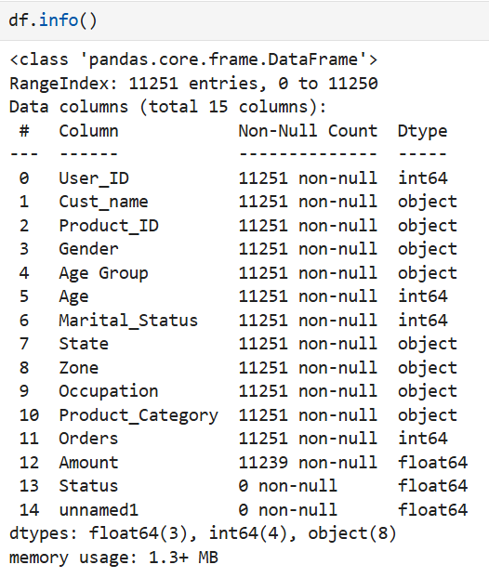
Overview of the Dataset

Slide 4
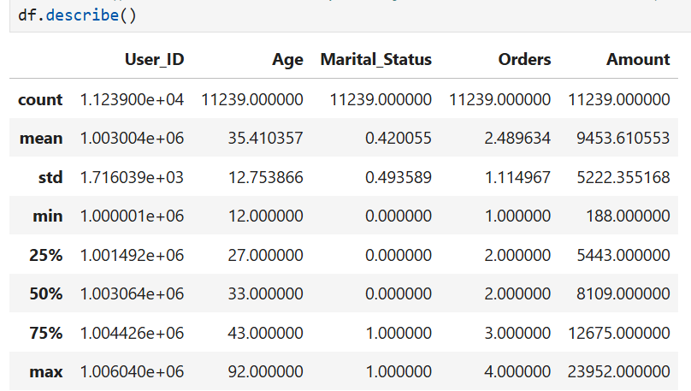
Statistical Summary

Slide 5
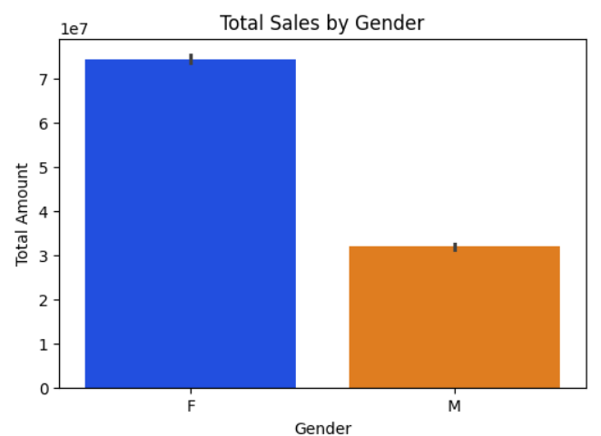
Gender Distribution of CUSTOMERS
The data clearly shows that female customers outnumbered male customers by a significant margin.
Female customers are the dominant participants in Diwali shopping.

Slide 6
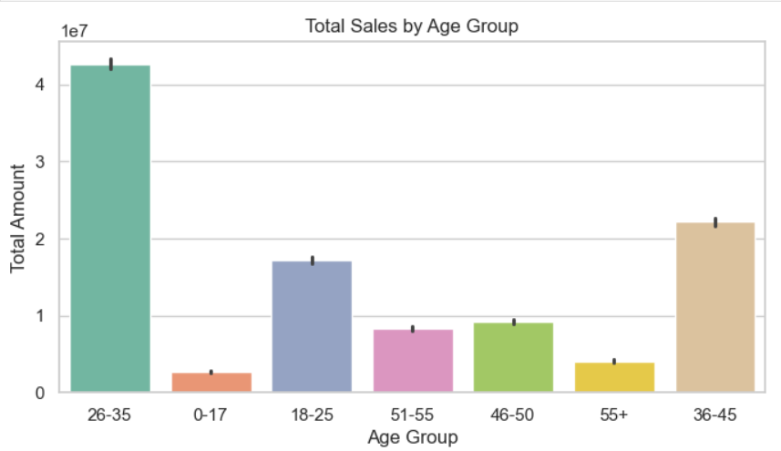
Total sales by Age Group
The 26–35 age group had the highest number of customers across both genders.
This was followed by the 36–45 and18–25 age groups.

Slide 7
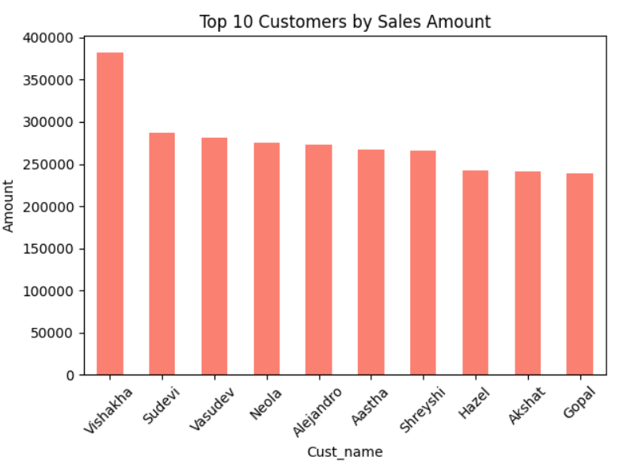
Top 10 customers by purchase amount

Slide 8
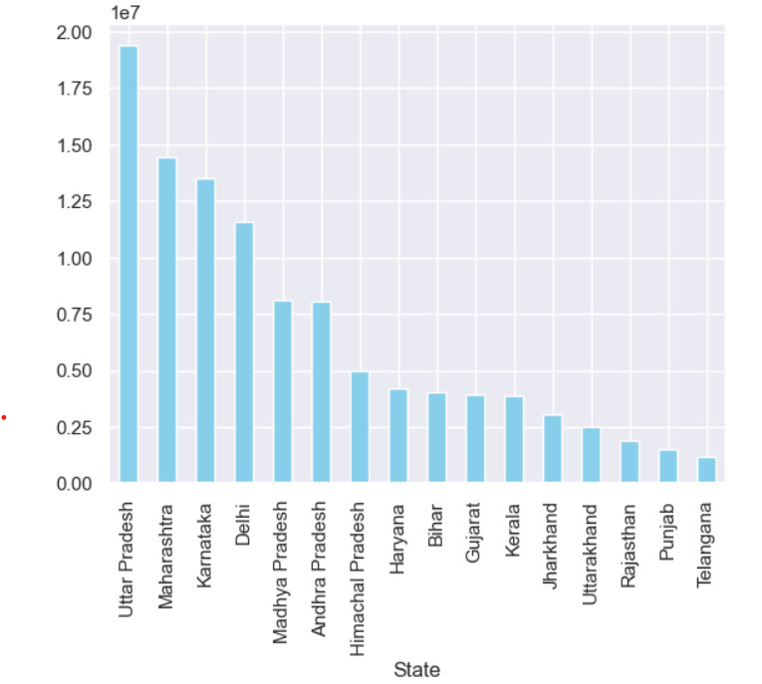
Total Sales by States
Data grouped by State and total sales
Top states with the highest sales revenue identified.
Highlights key revenue-generating regions for the business.
Provides insight into state-wise market strength.

Slide 9
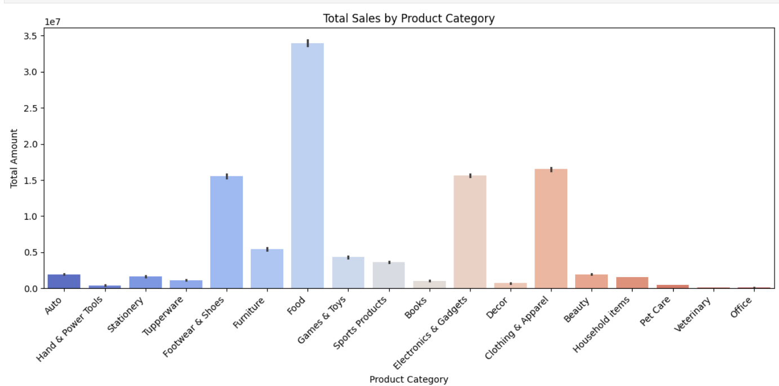
Total Sales by Product Categories
.
Data grouped by Product Category and total sales.
Useful for inventory planning and category-wise promotions.
Useful for understanding geographical demand patterns.
Helps understand customer preferences and demand trends.

Slide 10
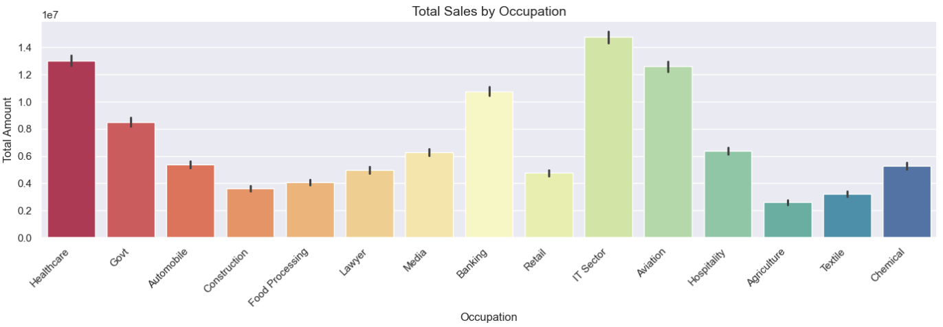
Total Sales By Occupation
Data grouped by Occupation and total sales.
Highlights which professions spend the most on purchases.
Useful for understanding consumer behavior by occupation.

Slide 11
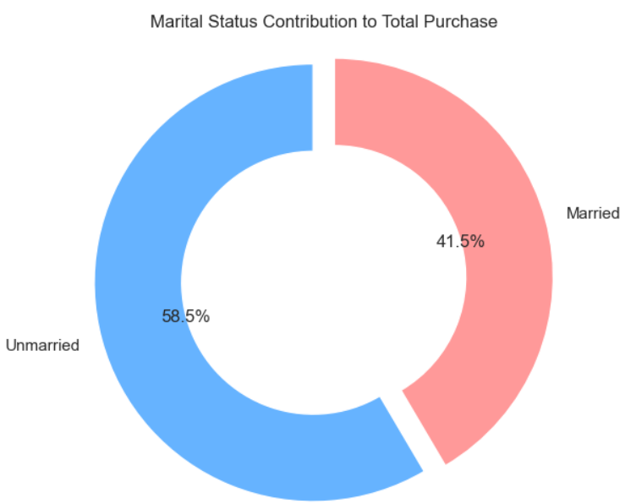
Marital Status vs Purchase
The percentage share of total sales contributed by Unmarried vs. Married customers.
Helps understand which group was more active in spending during Diwali — useful for targeted marketing and demographic insights.

Slide 12
conclusion
During the Diwali season, most sales came from states like Maharashtra, Karnataka, and Uttar Pradesh. People working in IT, healthcare, and aviation spent the most. Customers aged 26 to 45 were the top buyers. Food, clothing, and electronics were the most popular products. Sales were highest in big cities, and offering discounts on popular items can help boost future sales.

Slide 13
THANK YOU

